Slide 1

of
Game Cards
December 2nd, 2018
Team WildCard
Thuan Le (PO) | Art Parkeenvincha (S1 & S4 SM) | Kalyn Williams (S2 SM) | Kyle Lee (S3 SM)

Slide 2
We want to create a new card game and reinvent existing card games in one application.
Moti
vation
Notes:
Chance is a card game that will test your luck. Take a ‘Chance’.

Slide 3


Create an original card game named Chance.
Implement the card game Blackjack.
Implement multiplayer for Chance and Blackjack functionalities.
Go
als

Slide 4


Overall
Architecture
Scene
Unit
Testing
Chance
Blackjack

Slide 5
Player
Architecture
Player (Hand of cards)
Card Stack
Card Prefab
Card Model
Sprite Renderer
Sprites

Slide 6
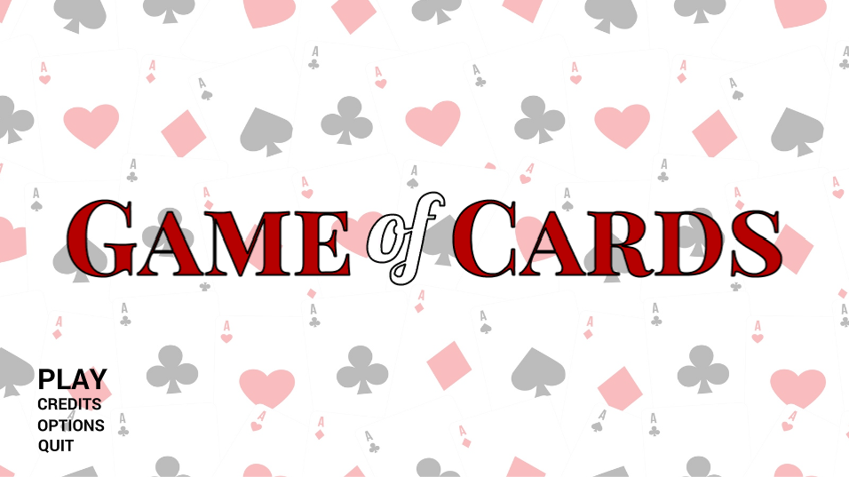

Slide 7
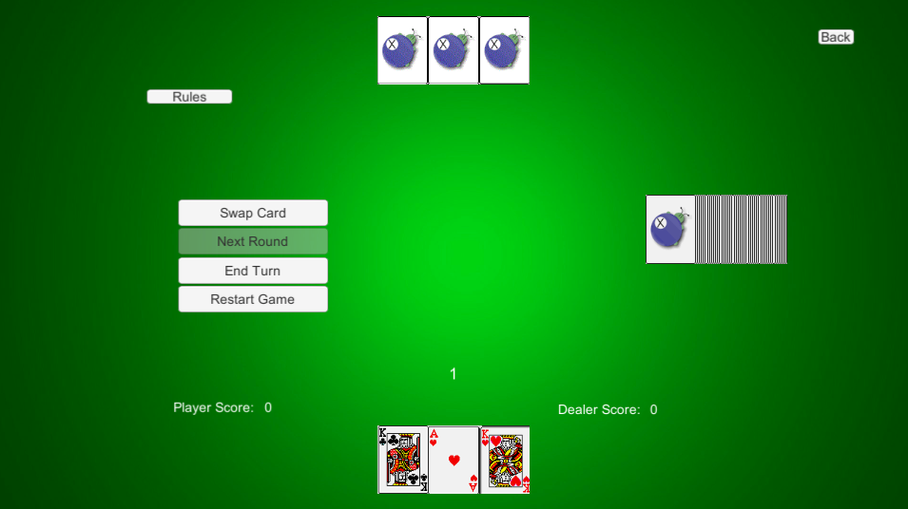
Chance

Slide 8
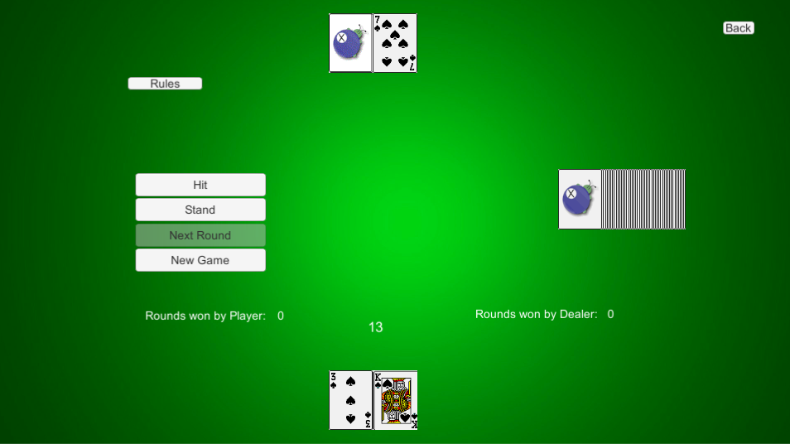
Blackjack

Slide 9



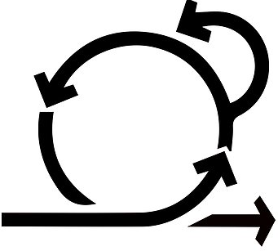
Project
Management
Techniques
SCRUM
GitHub
Slack
Trello
Planning Poker
Pair Programming
Code Review
Static Analysis Tools
Version Control
Communication
Automated- Reminders
SCRUM board

Slide 10




Schedule conflicts and managing other courseworks
Chall
enges
Implementing Multiplayer
Ų̵͖̣̭̣̬͖̻̽́̆̓͌̓̽͑̆͝N̷̼͉̦̘̘̟̹̪͕̩͑̑̕̕͝Ḯ̴͖͓̹̉̊̚͜͠Ţ̵̗͊̎̇͑̿Y̵̛͍̯̥̿̆.̴̧̲̬̘̺̰̦̹̗̌̓͗̕
UNITY.

Slide 11
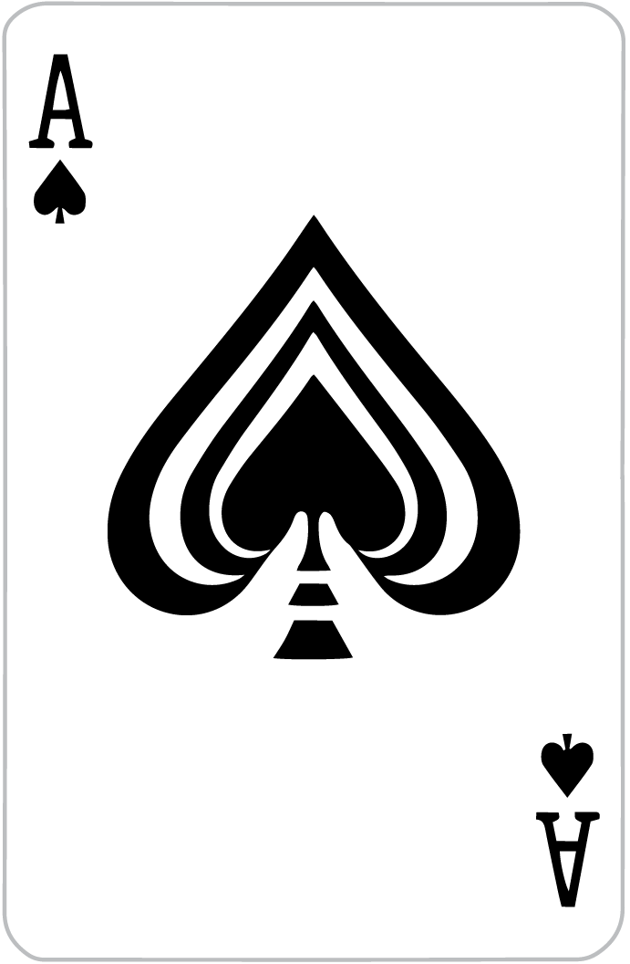
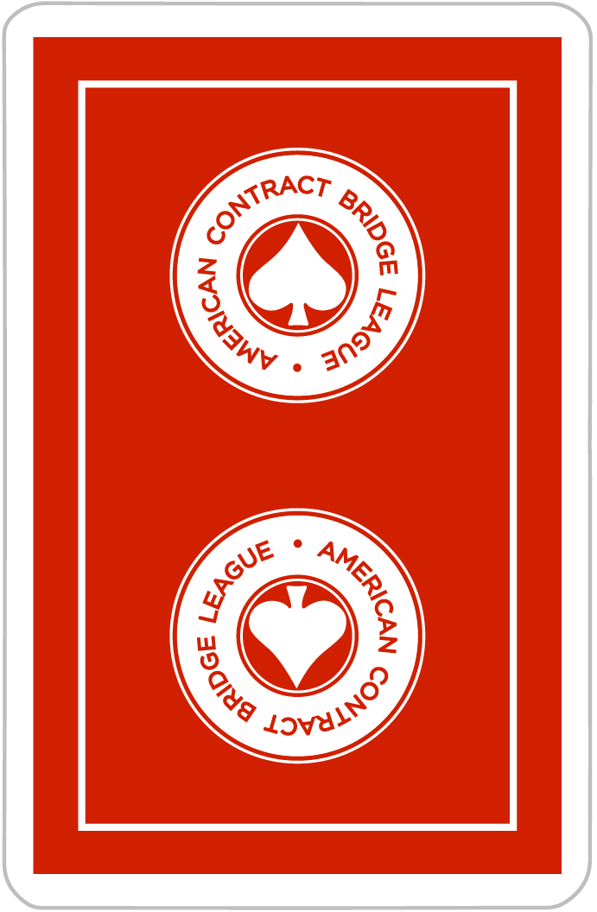
Things we enjoyed
Things we
didn’t enjoy
Learning version control with a team
Learning the process of making a 2D Game
Applying Scrum Agile methodologies
Resolving merge conflicts on Github
UNITY.

Slide 12
Pair programming works!
Individual programming does not work!
Wished we had more face to face meetings
Lessons
learned

